Slide 1
little east conference summit breakthrough to your best success
elizabeth hamilton-guarino

Slide 2
about me

Slide 3
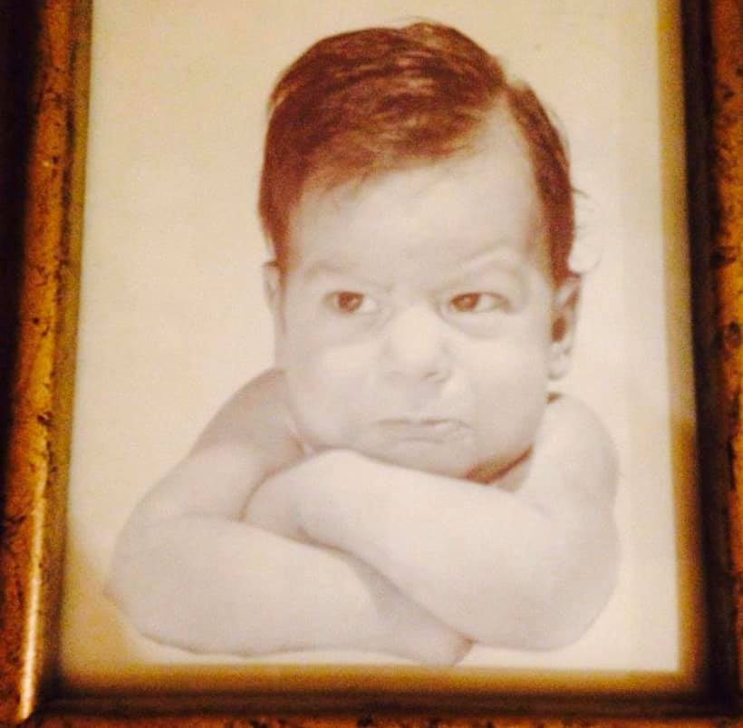
about me

Slide 4
the power of YOU
what i want you to know
what i don’t want you to know
what you want me to know
what you don’t want me to know

Slide 5
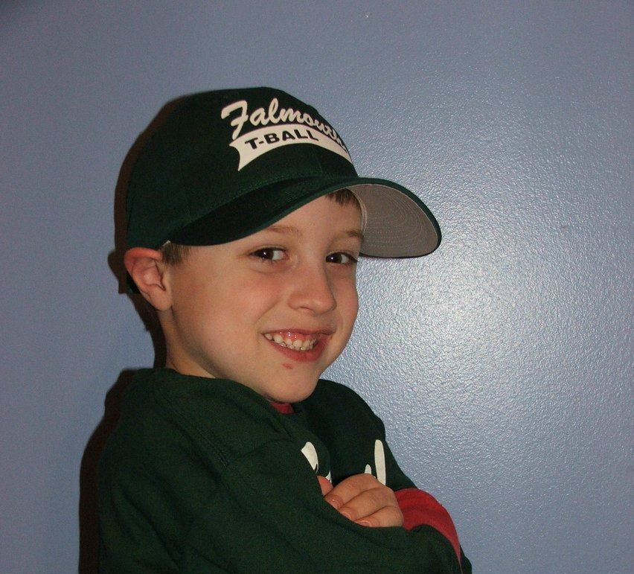
the power of I-ME-US-WE
your story

Slide 6
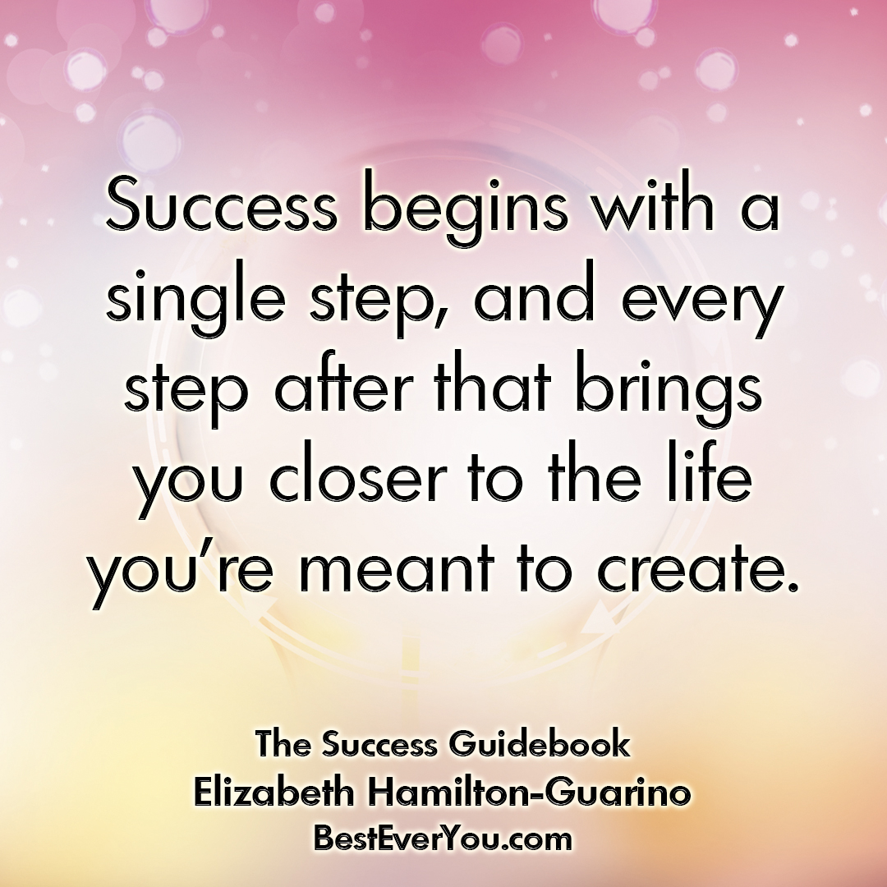
the ten factors of success
VISUALIZE
imagine
believe
focus
ACTUALIZE
plan
ask
network
AMPLIFY
collaborate
sustain
adjust
celebrate

Slide 8
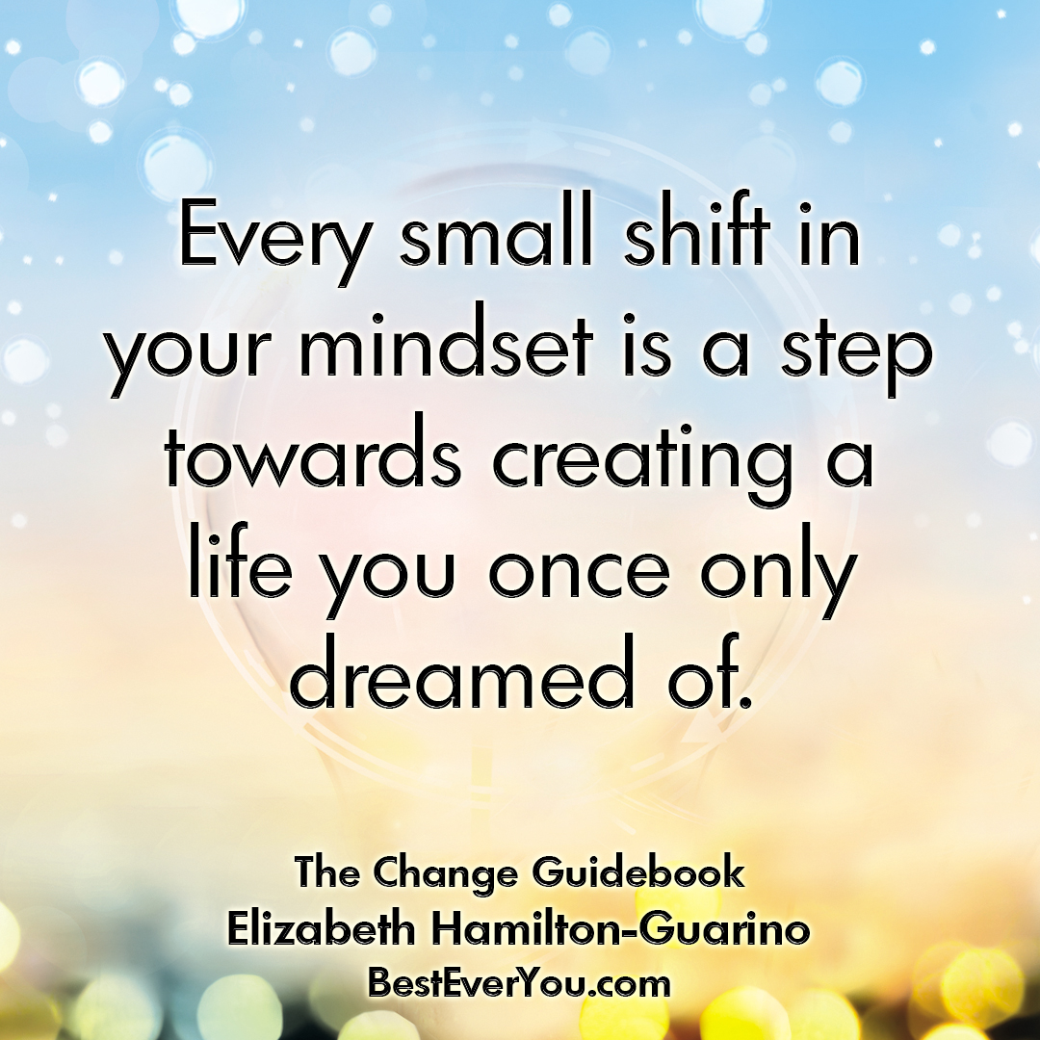
the power of gratitude
root in gratitude, foundation
gratitude transforms stress into strength
benefits: improved mental focus, resilience, and team cohesion
gratitude flip
perspective

Slide 9
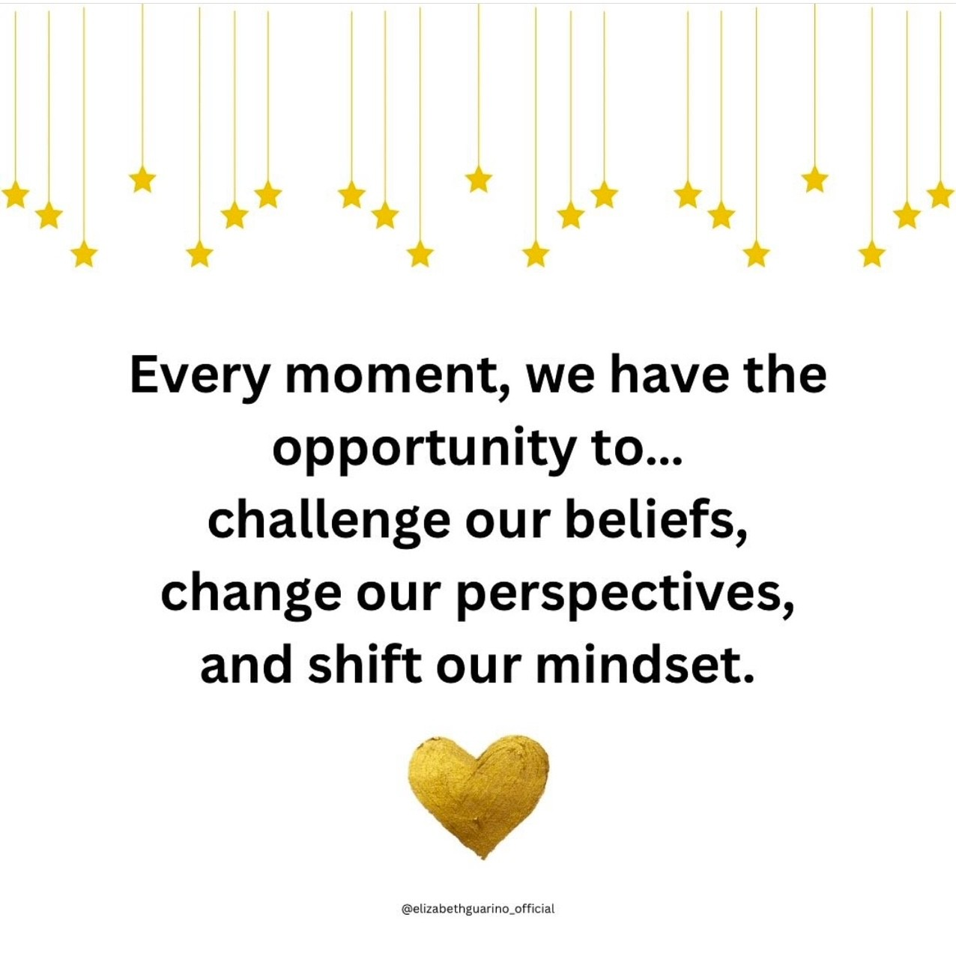
the power of true success
let’s redefine success personally and professionally
success isn’t confined to money, analytics, trophies, accolades, and whatever else
definitions of success change as we change, grow and age
let’s talk about enoughness

Slide 10
purpose and impact
purpose gives direction to talent
who needs you - who needs your story
be the hero of your own story
align your heart, truths, and energy

Slide 11
VISUALIZE imagine-believe-focus

Slide 12
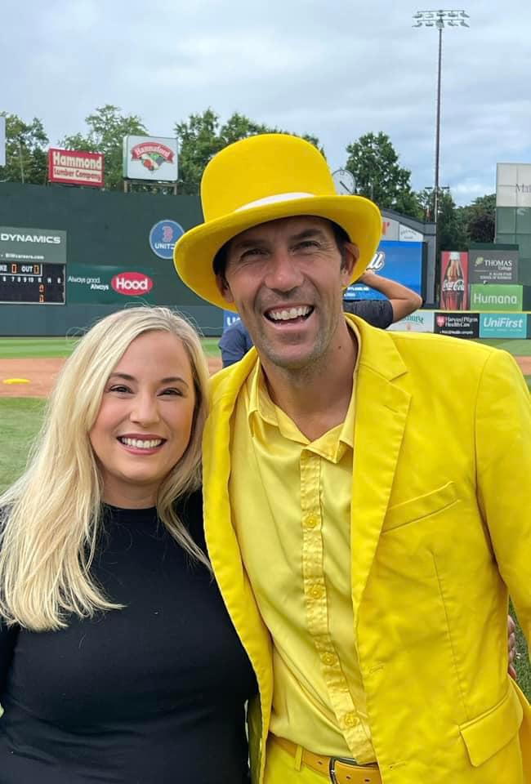
the power of imagine
see it
be it
do it
reach for the stars
strategies: elizabeth’s secret
savannah bananas

Slide 13
the power of believe
face adversity with confidence
go all in
circumvent the mediocre, naysayers
surround yourself with awesomeness
you can be as great as you think you are
authentic you

Slide 14
the power of focus
learn the 5 d’s (pg. 63)
learn your absolutes
focus on routine
eliminate things that don’t support your success

Slide 15
ACTUALIZE plan-ask-network

Slide 16
the power of plan
turn your dreams into reality
map out a plan
be the hero of your own story
explore
Evaluate (EAD)
change/resilience

Slide 17
the power of asking
asking is not a weakness
no success at any level is achieved alone
have people that aren’t afraid to tell you the truth in constructive way
pfs
find a way

Slide 18
the power of network
talking, listening, learning, connecting
what’s your networking purpose
make everybody feel like somebody
go above and beyond
questions
connect the dots
cookie crumbs
mentors

Slide 19
AMPLIFY collaborate-sustain-adjust-celebrate

Slide 20
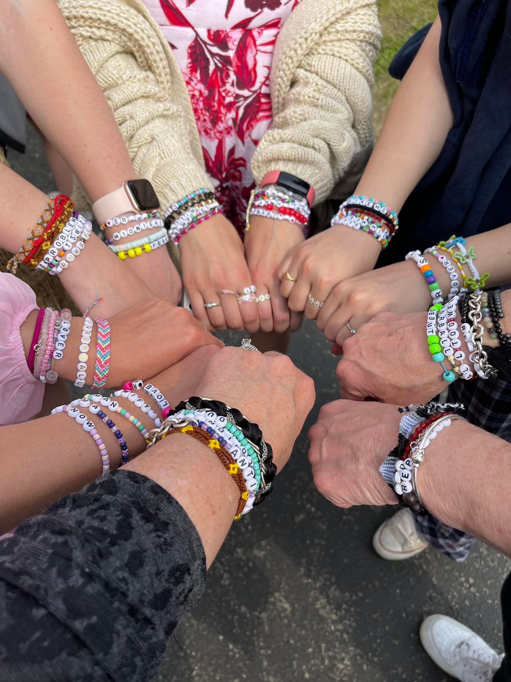
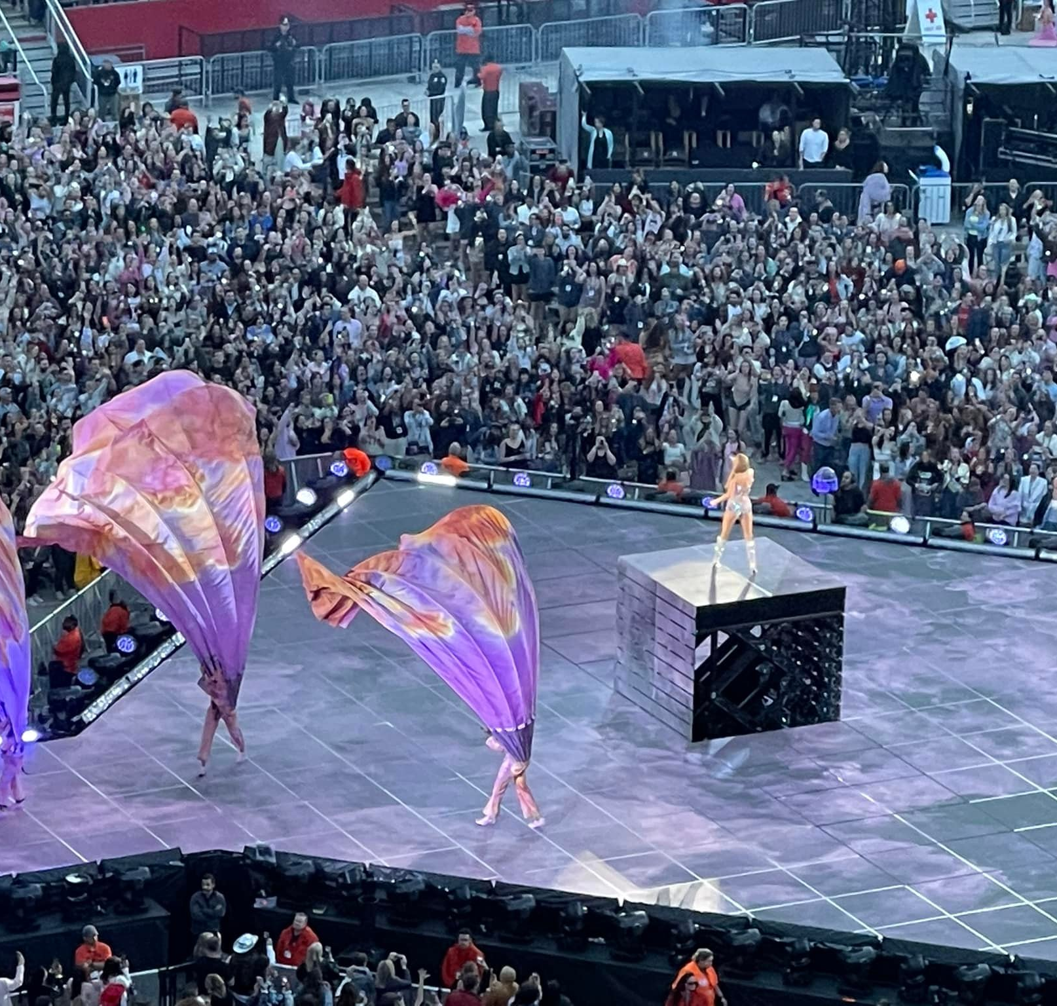
the power of collaborate
who’s your taylor swift in your life
culture, beliefs, actions, mindset
i-me-us-we
no success is achieved alone

Slide 21
teamwork what makes a great team

Slide 22
the power of sustain
create a foundation for lifelong success
operate from enoughness
be open to change, growth mindset
think long term

Slide 23
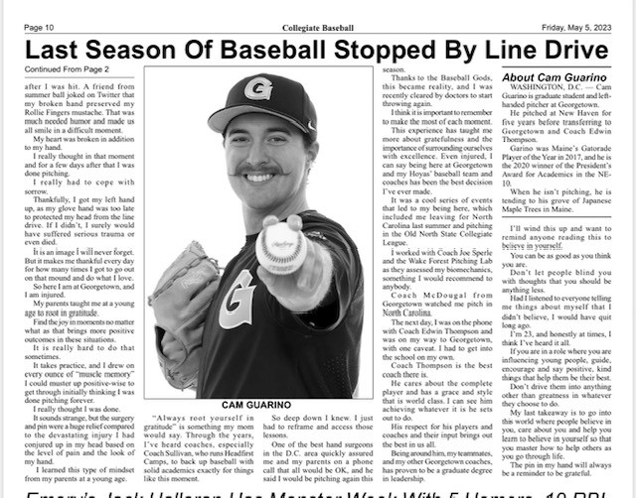
the power of adjust
embrace change
change is the foundation of progress
strategies: adapt, view challenges as opportunities, and learn from every outcome
process grief and loss
share your story

Slide 24
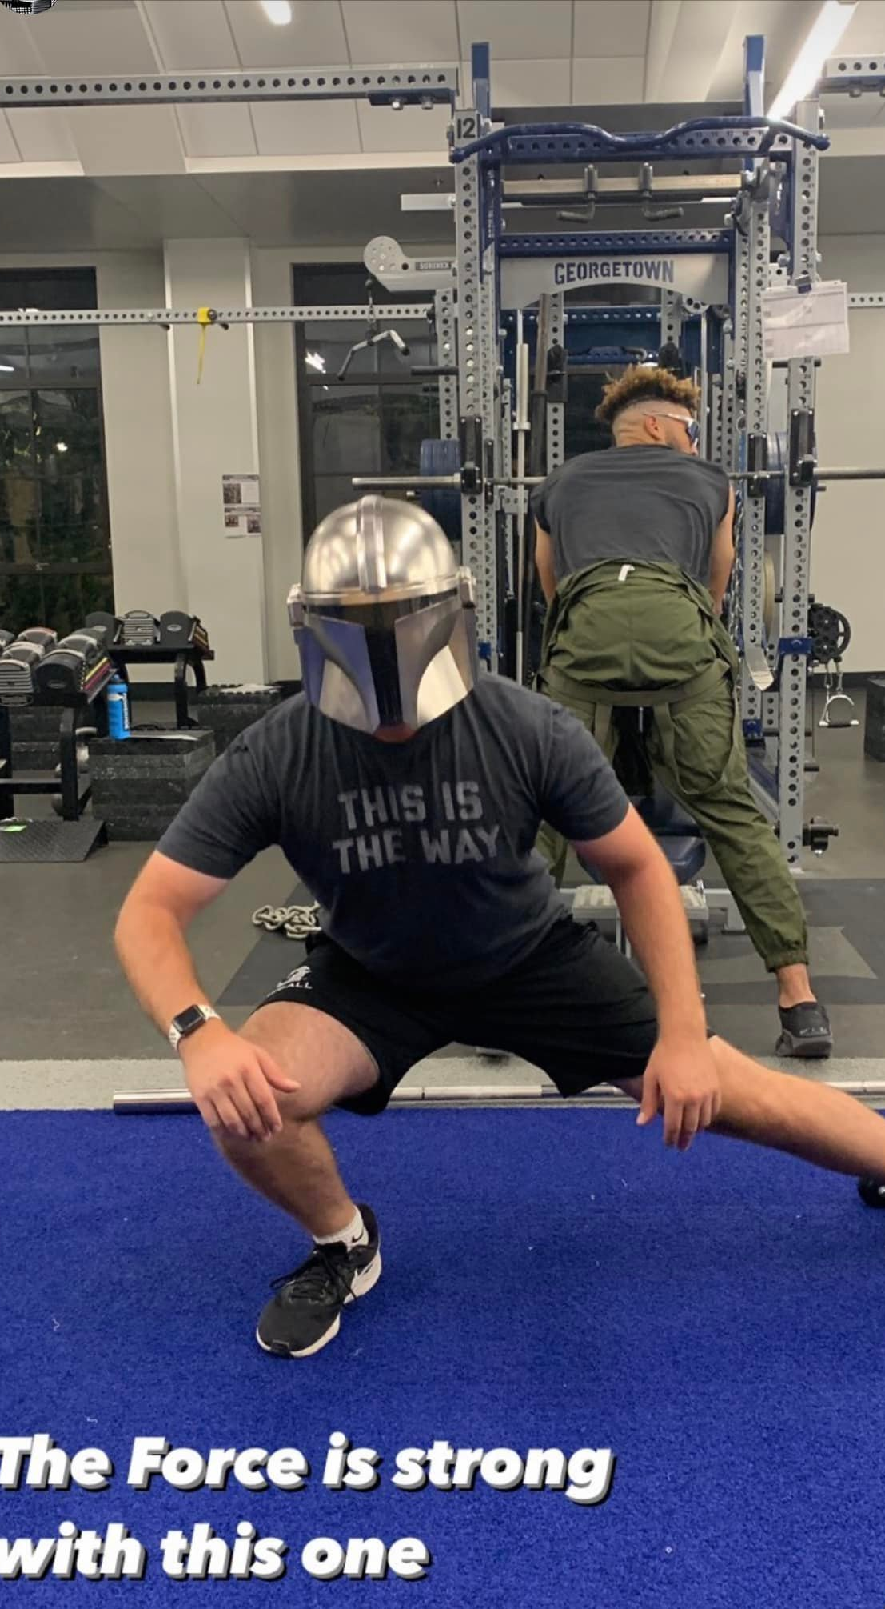
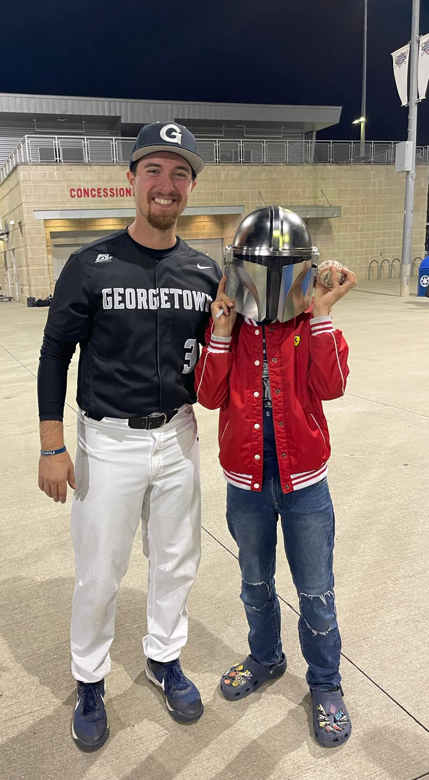
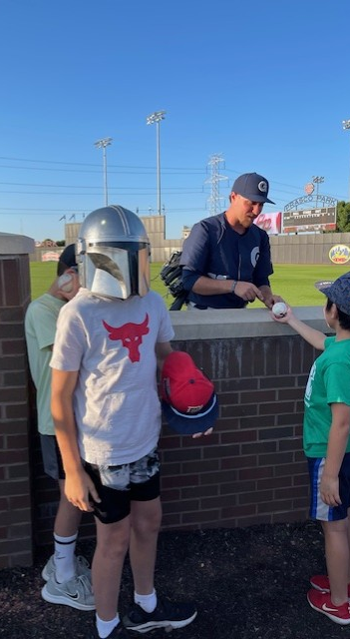
the power of your story
cam’s story

Slide 25
the power of adjust
embrace change
change is the foundation of progress
strategies: adapt, view challenges as opportunities, and learn from every outcome
process grief and loss
share your story

Slide 26
if I make this change will it be worth it risk change reward known unknown
Vacillate/oscillate - most people fear change

Slide 27
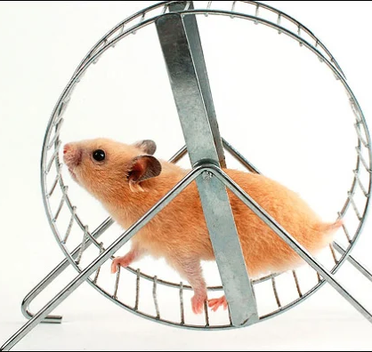
reduce the fear of change
is this in line with the essence of who i am
does this celebrate my unique skills and gifts
am i taking responsibility for my emotions, actions and behavior
how does this impact others around me and the world as a whole
does this moment or action contribute to my longevity and health
is my mind at peace and my spirit content

Slide 28
the power of celebrate
count your blessings
find those that need your help
let your superpowers shine
share your why
success stacking
percolate peace

Slide 29
As you take the next step, what do you want to take with you?

Slide 30
Thank You!!
elizabeth hamilton-guarino
elizabethguarino.com
besteveryou.com
instagram: elizabethguarino_official

